Slide 1
EMTrack for Mass Vaccination
Training for IDPH and Illinois LHD Administrators and Super Users

Slide 2
Curtis McDonald, LP
Solutions Implementation Manager
Licensed Paramedic – Texas
Texas Emergency Medical Task Force – Task Force Leader
Hurricane Harvey
Transportation Branch Manager and Medical Operations Chief
Hurricanes Katrina, Rita, Gustav, Ike

Slide 3
Agenda
Learning Objectives
Process Review
EMTrack Live Training
Q & A

Slide 4
Learning Objectives
Understand the workflow of patient tracking for mass vaccination
Understand roles and responsibilities before, during, and after a tracking event
Demonstrate the ability to manipulate a patient record during all phases of tracking

Slide 5
Process Review (Simplified)
LHDs Determines Event Logistics
Residents schedule appointments
LHDs administer the vaccine
Data sent to I-CARE

Slide 6
Process Review
LHDs Set Up Events
Residents schedule appointments
LHDs administer the vaccine
Data sent to
I-CARE
LHD Completes Form Requesting Event Setup
Juvare staff sets up event or contacts LHD staff for follow-up within 24 hours
LHD Requests Modification If Needed

Slide 7
Process Review
LHDs Set Up Events
Residents schedule appointments
LHDs administer the vaccine
Data sent to I-CARE
Resident receives ticket with barcode
Eligible resident schedules an appointment and submits demographic information
Resident answers screening questions on website
Resident receives text & email confirmation
Residents arrives at vaccine location with ticket
Residents receives reminder for 2nd dose
Screening questions are common across all sites and approved by IDPH.
We also have suggested workflow for Closed PODs that we will share.
Resident receives text & email reminder
For residents that forget their barcode tickets, you may look them up by their demographic information.
The language of the text messages is reviewed and approved by IDPH.

Slide 8
Process Review
LHDs Set Up Events
Residents schedule appointments
LHDs administer the vaccine
Data sent to I-CARE
Residents arrives at vaccine location with ticket
Vaccine Administrator Reviews Patient History
LHD staff check in patient
Lane Management
Vaccine Administration & Recording
15-minute Observation & Discharge
Patient Receives “Thank You” message
Residents arrives without preregistration
VXU Lookup
Recording Adverse Reactions

Slide 9
POD Flow – Small Not Recommended
Registration / Check In & Screening
Vaccination, Observation & Discharge
Each Station Requires at least staff member
Only Two Stations
Very Limited Throughput
Only for very small PODS with limited staff

Slide 10
POD Flow – Medium POD
Registration / Check In & Screening
Vaccination
Observation & Discharge
OR
Registration / Check In
Screening & Vaccination
Observation & Discharge
Each Station Requires at least staff member
Combines the Screening Process with either
Registration or Vaccination Administration
Observation and Discharge combined in one station

Slide 11
POD Flow – Standard
Registration / Check In
Screening
Vaccination
Observation
Check out / Discharge
Each Station Requires at least staff member
Best separation of tasks
Can optimize based on throughput
Each station can be scaled
One Registration station
One Screening station
Three Vaccination stations (etc)

Slide 12
EMTrack Concepts
Unique ID
Bar Codes 101
ID Scanning
Scanning Tools
Getting In & Navigation
Data Entry and Forms
Dashboards and Filters
Facility and User Management

Slide 13
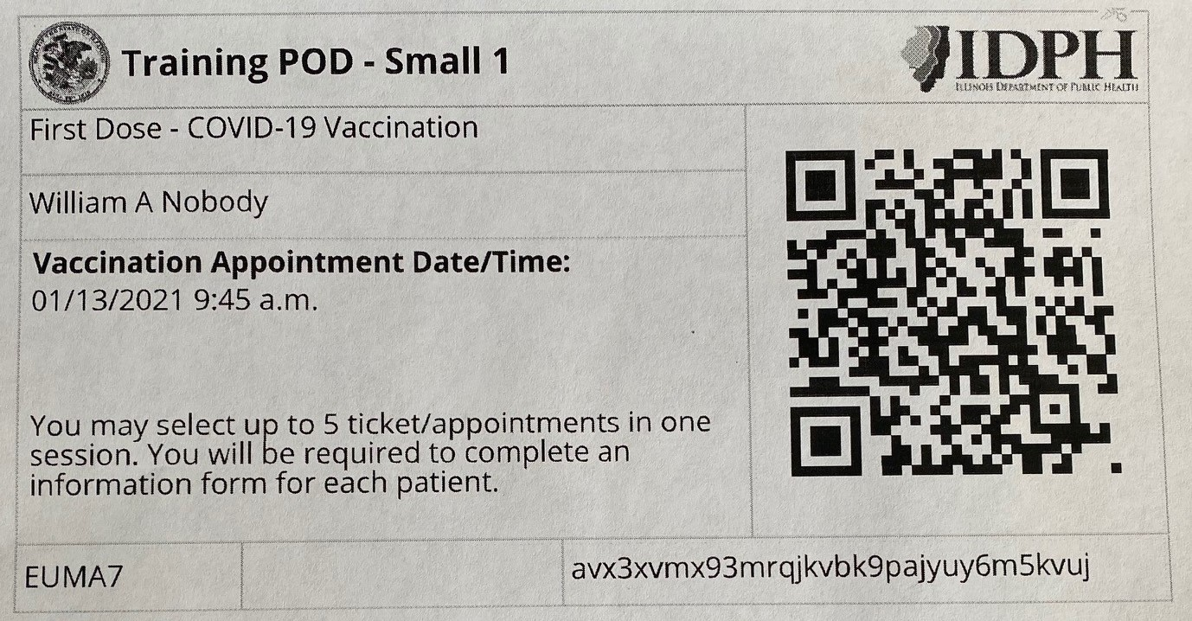
Background : Patient Tracking The Unique ID

Slide 14
Barcodes 101
1D Barcode: Triage Tags, UPC Barcodes
How can you tell? Vertical lines
Purpose: Scan data that appears below barcode
2D Barcode: Driver’s Licenses
How can you tell? Vertical & Horizontal lines
Contains a data set (not just a bar code number)
Notes:
Within mobile apps can ID scan-able barcode types.

Slide 15
Barcodes 101
Create your own Barcodes!
“Free 3 of 9” Barcode Font
Place an * on each end of text
For “AdamsCoLHD00001” enter “*AdamsCoLHD00001*” = *AdamsCoLHD00001*
Can be used in Word or Excel
Notes:
Within mobile apps can ID scan-able barcode types.

Slide 16
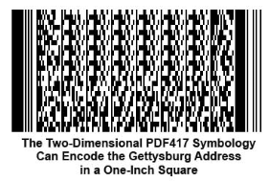
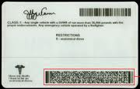
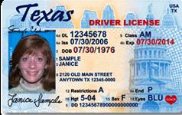
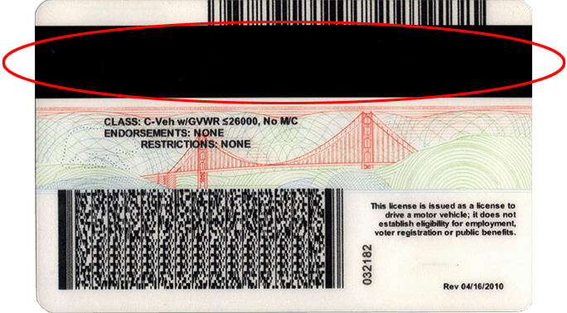
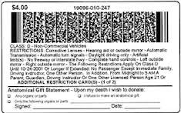
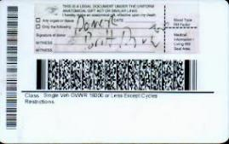
Driver's License Scanning

Slide 17
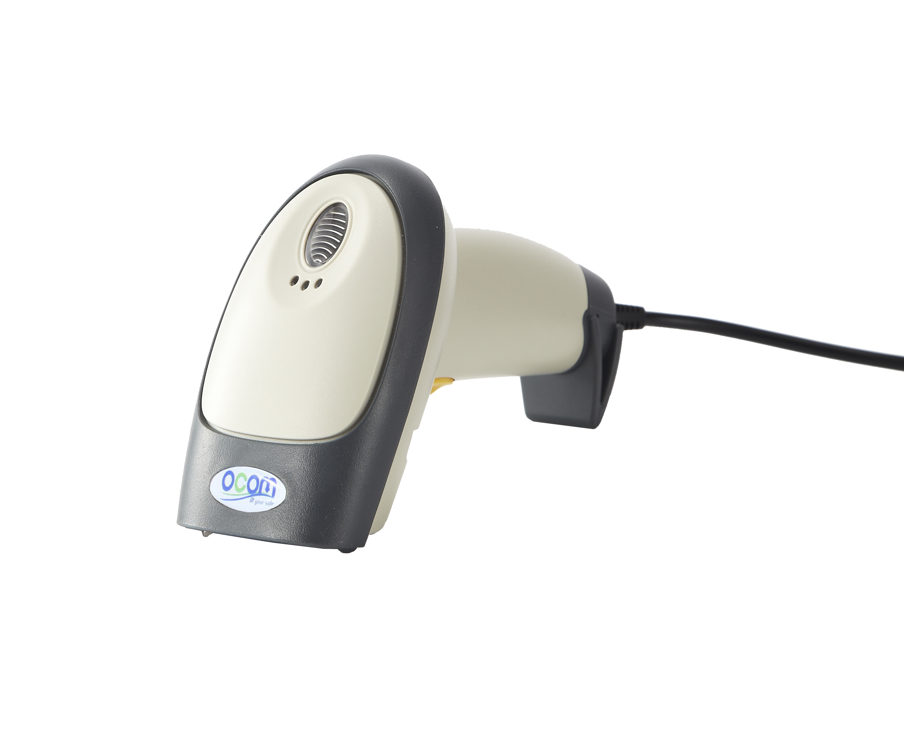
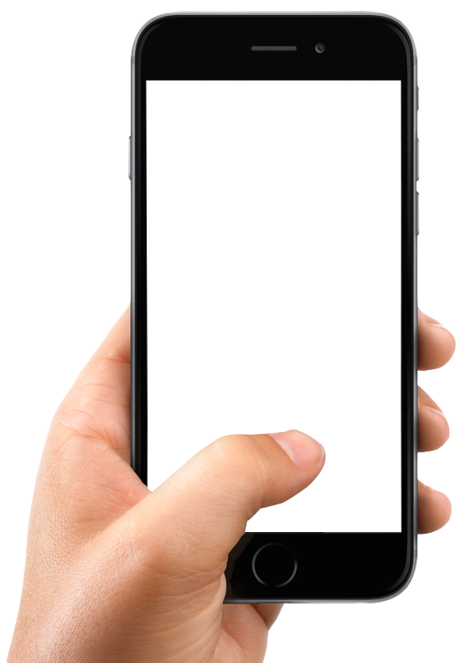
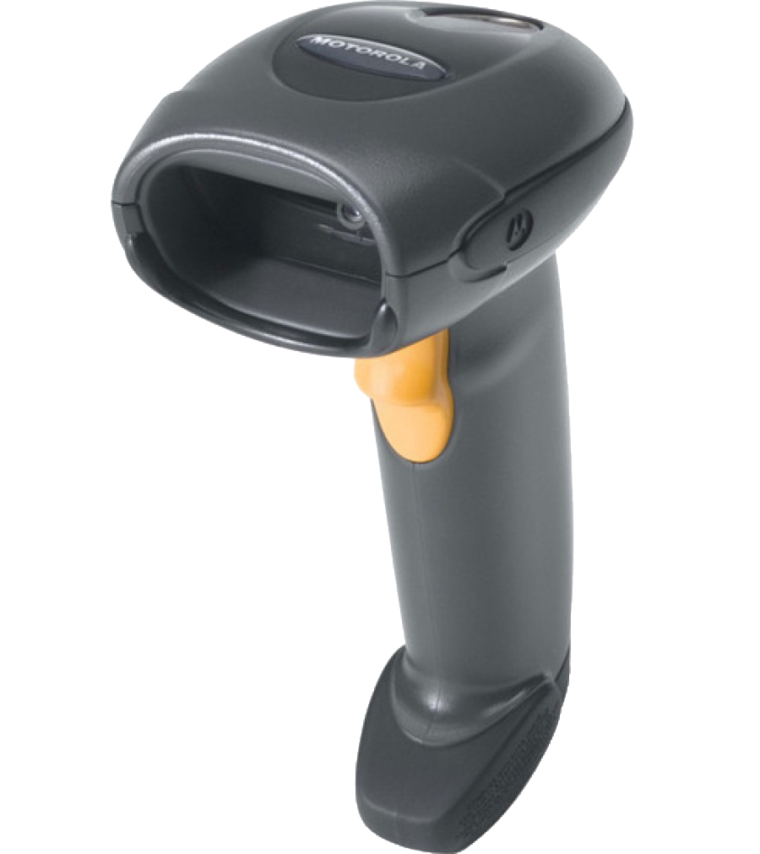
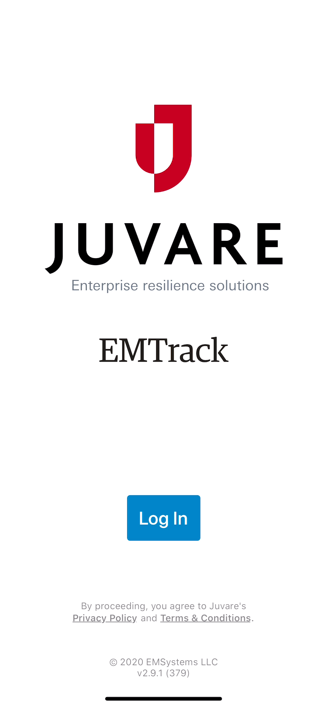
Other scanning tools
2D Scanner / Smart Phone Required for:
Drivers License Scanning
Ticket Scanning

Slide 18
Demonstration

Slide 19
Questions & Answers

